Slide 1
Introduction to DEB theory in ecotoxicolgy
Gonçalo M. Marques goncalo.marques@tecnico.ulisboa.pt

Slide 2
Content
DEB Modes of Action (MoA)
Survival
Sub-lethal effects
Mixtures

Slide 3
Standard DEB model
$$\frac{dE}{dt}={\dot{p}}_{A}−{\dot{p}}_{C}$$
$${\dot{p}}_{A}=\left\{{\dot{p}}_{Am}\right\} f\left(X\right) V^{2/3}$$
$${\dot{p}}_{C}=E\frac{{\left[E_{G}\right]\dot{v}}/L+\left[{\dot{p}}_{S}\right]}{κ\left[E\right]+\left[E_{G}\right]}$$
$$\frac{dV}{dt}=\frac{{\dot{p}}_{G}}{\left[E_{G}\right]}$$
$${\dot{p}}_{S}=\left[{\dot{p}}_{M}\right]V+\left\{{\dot{p}}_{T}\right\} V^{2/3}$$
for non-adults
$$\frac{dE_{H}}{dt}={\dot{p}}_{R}$$
$${\dot{p}}_{G}=κ{\dot{p}}_{C}−{\dot{p}}_{S}$$
$$\frac{dE_{R}}{dt}=κ_{R}{\dot{p}}_{R}$$
$${\dot{p}}_{J}={\dot{k}}_{J}E_{H}$$
for adults
$${\dot{p}}_{R}=\left(1−κ\right){\dot{p}}_{C}−{\dot{p}}_{J}$$
Hybrid dynamical system
Notes:
3

Slide 4
DEB MoA
Assimilation
Maintenance
Growth
Reproduction
Survival

Slide 5
Survival
$$S$$
$$h\left(t\right)$$
hazard
$$S\left(t\right)=\text{exp}\left(−\int_{0}^{t}{h\left(s\right)ds}\right)$$
$$t$$

Slide 6
Survival
$$S$$
$$h\left(t\right)=0$$
hazard
$$S\left(t\right)=\text{exp}\left(−\int_{0}^{t}{h\left(s\right)ds}\right)$$
$$t$$

Slide 7
Survival
$$S$$
$$1$$
$$h\left(t\right)=0$$
hazard
$$S\left(t\right)=1$$
$$t$$

Slide 8
Survival
$$S$$
$$1$$
$$h\left(t\right)=h_{0}$$
hazard
$$S\left(t\right)=\text{exp}\left(−h_{0}t\right)$$
$$t$$

Slide 9
Survival
$$S$$
$$1$$
$$h\left(t\right)=h_{0}+h_{c}\left(t\right)$$
$$h_{c}\left(t\right)={\dot{b}}_{†} \text{max}\left(0, C\left(t\right)−C_{0}\right)$$
killing rate
NEC
$$t$$
$$C\left(t\right)=c\left(1−\text{exp}\left(−{\dot{k}}_{e}t\right)\right)$$
elimination rate

Slide 10
Survival
$$S$$
$$1$$
$$h\left(t\right)=h_{0}+h_{c}\left(t\right)$$
$$h_{c}\left(t\right)={\dot{b}}_{†} \text{max}\left(0, C\left(t\right)−C_{0}\right)$$
killing rate
NEC
$$t$$
$$C\left(t\right)=c\left(1−\text{exp}\left(−{\dot{k}}_{e}t\right)\right)$$
elimination rate

Slide 11
Sub-lethal effects
$$×(1+s)$$
par
$$c_{V}$$
NEC

Slide 12
Sub-lethal effects
$$×(1+s)$$
par
$$s=\frac{1}{c_{T}}\text{max}\left(c_{V}−c_{0},0\right)$$
$$c_{V}$$
NEC

Slide 13
Sub-lethal effects
$$×(1+s)$$
$$×(1−s)$$
par
$$/(1+s)$$
$$c_{V}$$
NEC

Slide 14
Single compound
$$c_{V}$$
$$t$$

Slide 15
Single compound
$$c_{V}$$
$$\left[{\dot{p}}_{M}\right]$$
NEC
$$t$$
$$c_{V}$$
NEC

Slide 16
Single compound
$$c_{V}$$
$$\left[{\dot{p}}_{M}\right]$$
NEC
$$t$$
$$c_{V}$$
NEC

Slide 17
Single compound
$$c_{V}$$
$$\left[{\dot{p}}_{M}\right]$$
NEC
$$t$$
NEC
$$c_{V}$$

Slide 18
Single compound
$$c_{V}$$
$$\left[{\dot{p}}_{M}\right]$$
NEC
$$t$$
$$c_{V}$$
NEC

Slide 19
Single compound
$$c_{V}$$
$$\left[{\dot{p}}_{M}\right]$$
NEC
$$t$$
$$c_{V}$$
NEC

Slide 20
Single compound
$$c_{V}$$
$$\left[{\dot{p}}_{M}\right]$$
NEC
$$t$$
$$t$$

Slide 21
Mixtures

Slide 22
Mixture
independent
$$c_{V}$$
NEC
NEC
$$t$$

Slide 23
Mixture
independent
$$c_{V}$$
$$\left[{\dot{p}}_{M}\right]$$
NEC
NEC
$$t$$
$$t$$

Slide 24
Mixture
independent
$$c_{V}$$
$$\left[{\dot{p}}_{M}\right]$$
NEC
NEC
$$t$$
$$t$$

Slide 25
Mixture
independent
$$c_{V}$$
$$\left[{\dot{p}}_{M}\right]$$
NEC
NEC
$$t$$
$$t$$

Slide 26
Mixture
independent
NEC
NEC

Slide 27
Mixture
dependent
independent
NEC
NEC
NEC

Slide 28
Mixture
dependent
independent
NEC
NEC
NEC
The mixture NEC is fixed when the fractions of the
internal concentrations to their respective NECs sum to 1

Slide 29
Mixture
dependent
$$c_{V}$$
NEC
NEC
$$t$$

Slide 30
Mixture
dependent
$$c_{V}$$
$$1$$
NEC
NEC
$$t$$
$$t$$

Slide 31
Mixture
dependent
$$c_{V}$$
$$1$$
NEC
NEC
$$t$$
$$t_{0}$$
$$t$$

Slide 32
Mixture
dependent
$$c_{V}$$
$$1$$
NEC
$$w_{1}$$
NEC
$$w_{2}$$
$$t$$
$$t_{0}$$
$$t$$
$$h_{c}\left(t\right)=\sum_{i}{{\dot{b}}_{i} \text{max}\left(0, C_{i}\left(t\right)−w_{i}C_{i}^{0}\right)}$$

Slide 33
Mixture
dependent
$$c_{V}$$
$$1$$
NEC
$$w_{1}$$
NEC
$$w_{2}$$
$$t$$
$$t_{0}$$
$$t$$
Irreversible binding
locked $w_{i}$
$$h_{c}\left(t\right)=\sum_{i}{{\dot{b}}_{i} \text{max}\left(0, C_{i}\left(t\right)−w_{i}C_{i}^{0}\right)}$$

Slide 34
Mixture
dependent
$$c_{V}$$
$$1$$
NEC
$$w_{1}$$
NEC
$$w_{2}$$
$$t$$
$$t_{0}$$
$$t$$
Irreversible binding
locked $w_{i}$
$$w_{i}={C_{i}}/{C_{i}^{0}}{\left(\sum_{i}{{C_{i}}/{C_{i}^{0}}}\right)}^{−1}$$
$$h_{c}\left(t\right)=\sum_{i}{{\dot{b}}_{i} \text{max}\left(0, C_{i}\left(t\right)−w_{i}C_{i}^{0}\right)}$$
Reversible binding

Slide 35
Mixture
dependent
$$c_{V}$$
$$1$$
NEC
$$w_{1}=w_{2}=0.5$$
NEC
$$t$$
$$t_{0}$$
$$t$$
Irreversible binding
locked $w_{i}$
$$w_{i}={C_{i}}/{C_{i}^{0}}{\left(\sum_{i}{{C_{i}}/{C_{i}^{0}}}\right)}^{−1}$$
$$h_{c}\left(t\right)=\sum_{i}{{\dot{b}}_{i} \text{max}\left(0, C_{i}\left(t\right)−w_{i}C_{i}^{0}\right)}$$
Reversible binding

Slide 36
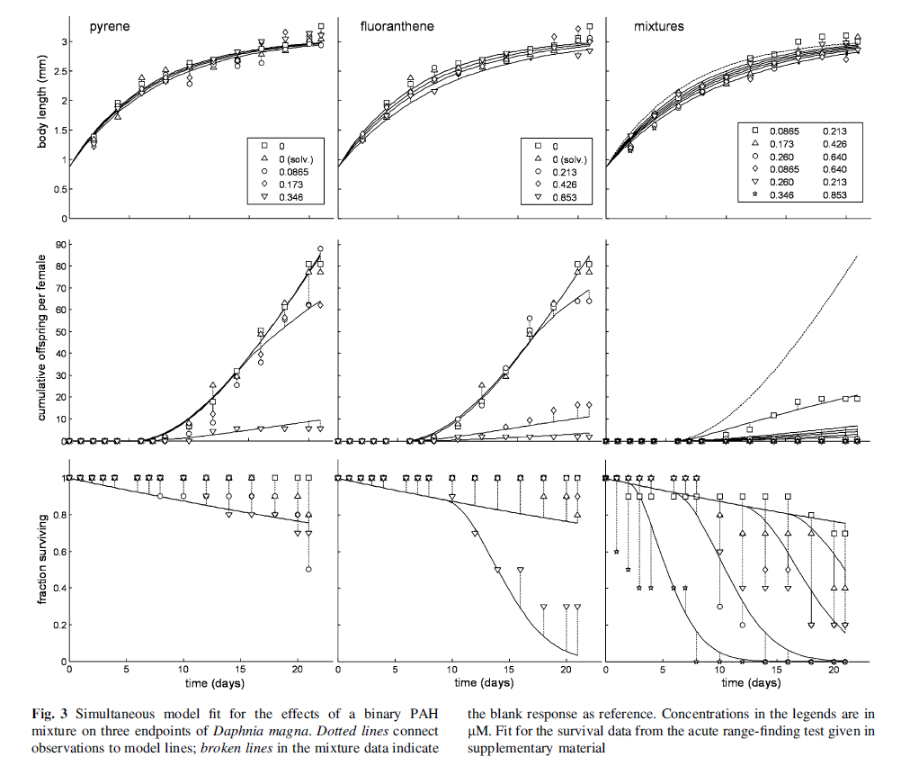

Slide 37
Mixtures

Slide 40
Single compound
int conc
$$\left[{\dot{p}}_{M}\right]$$
NEC
t
NEC
int conc

Slide 41
Single compound
int conc
$$\left[{\dot{p}}_{M}\right]$$
NEC
t
t

Slide 42
Mixture
independent
int conc
$$\left[{\dot{p}}_{M}\right]$$
NEC
NEC
t
t

