Slide 1


Don't let data ruin a perfectly good theory

Slide 2
y
0
x

Slide 3
“It is the theory which decides what can be observed”
― Albert Einstein

Slide 4
MECHANISTIC MODEL IS AN IDEALIZED REPRESENTATION OF REALITY…
y
0
x

Slide 5
… AND MAY BE CORRECT…
(or at least not rejected)
y
0
x

Slide 6
…BUT…
Treatment A
Treatment B
Treatment C
y
0
x

Slide 7
Don't let data ruin a perfectly good theory
theory
data
(mis)use of theory and situational DEB modeling

Slide 8
Ecotoxicology
DEB
MODEL
TOXICOKINETICS
TOXICODYNAMICS
TOXICANT TRANSFORMATION

Slide 9
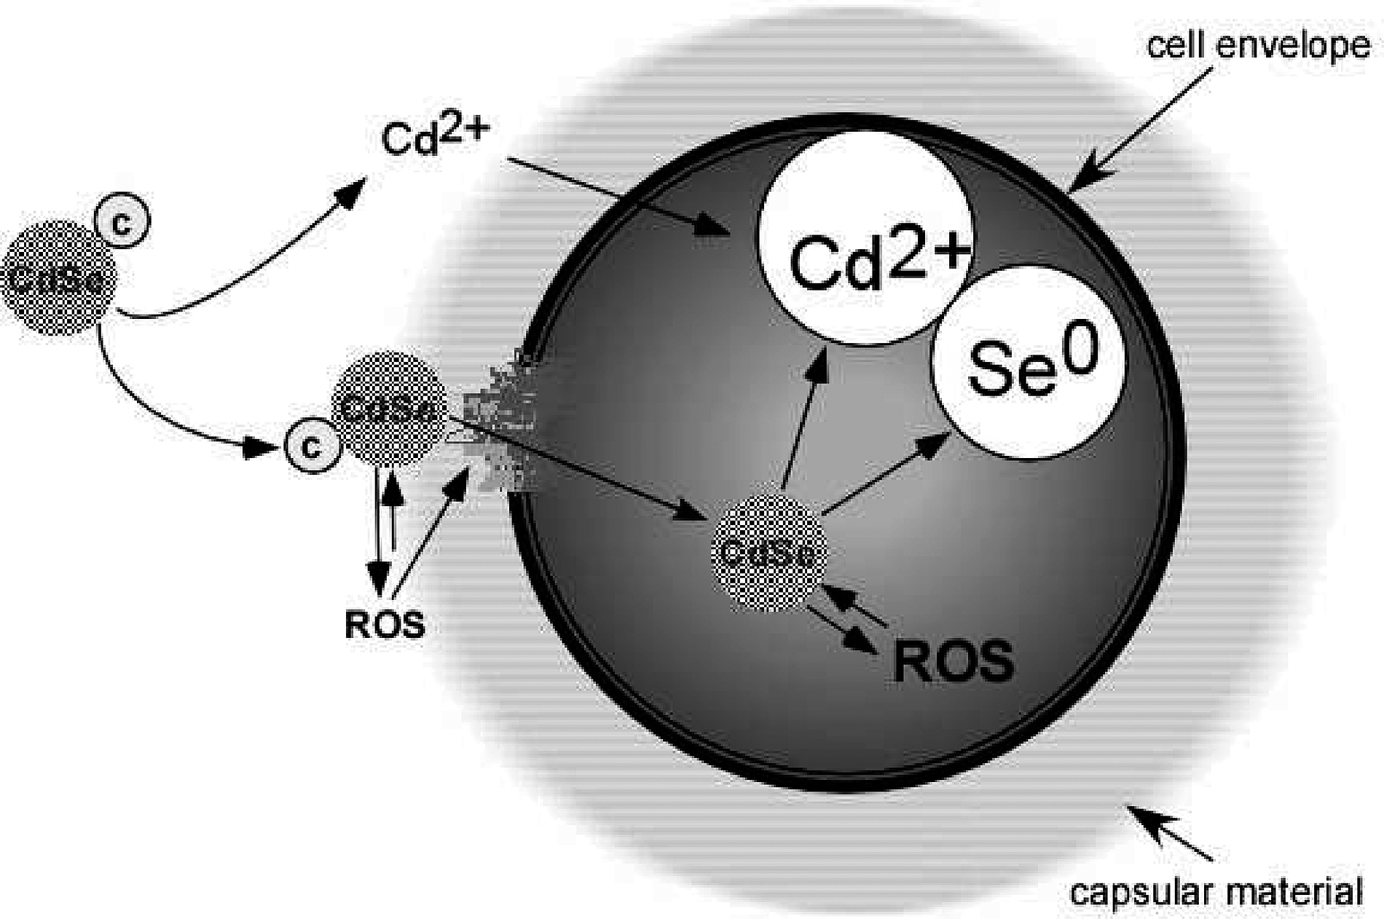
Cellular effects of CdSe quantum dots (QDs)
CdSe
‘CLASSIC’ and ‘NANO’ toxicity
CdSe
CdSe
ROS – Reactive oxygen species
Figure from: Priester et al. 2008

Slide 10
Cellular effects of QDs
Pseudomonas aeruginosa
Growth in microplates
  Control (no exposure)
  7 concentrations Cd(II)
  6 concentrations CdSe QDs
  Measurement of free radicals at the end (H₂O₂ equivalents)
Data and statistical analysis published in Priester et al. (2009)
Klanjscek et al. 2012, 2013

Slide 11
control
Increase in concent

Slide 12
Modelling control – standard model
DATA
(CALIBRATED OD)
MAINTENANCE
.
Fit Compare
Substrate
concentration, S
Assim.
Energy reserve
density, e
Growth
cell
conc., V

Slide 13
Modelling control
BIOMASS
HOURS

Slide 14
Modelling control
DATA
(CALIBRATED OD)
Environmental
degradation, ε
MAINTENANCE
.
Reduce
Fit Compare
Substrate
concentration, S
Assim.
Energy reserve
density, e
Growth
cell
conc., V

Slide 15
Modelling control
BIOMASS
modified
HOURS

Slide 16
The complete model
DATA
(CALIBRATED OD)
Environmental
degradation, ε
MAINTENANCE
.
ACCLIMATION, ε
Reduce
Fit Compare
Substrate
concentration, S
Assim.
Energy reserve
density, e
Growth
cell
conc., V
.
INCREASE
Inhibit
CAUSE
MORTALITY
DAMAGE-INDUCING
COMPOUNDS, q
Increase
HAZARD, h
Dissolved OM
INCREASE
Toxicant
conc., C_{OUT}
Bioaccu-
mulation
Toxicant
density, [C_{IN}]

Slide 17
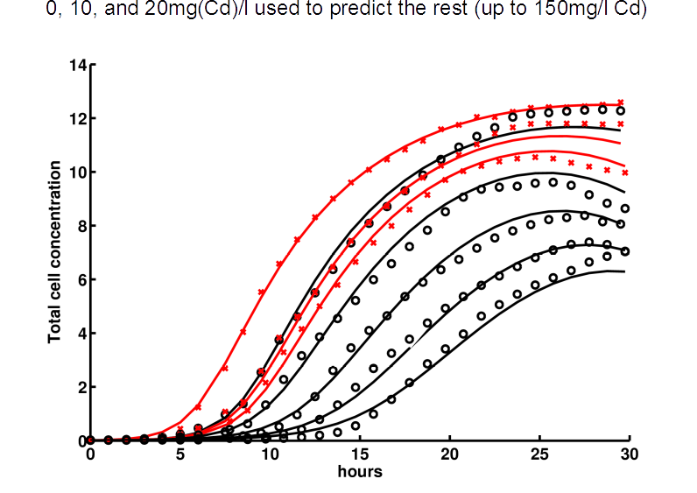


Predicting effects of exposure
Effects of exposure up to 150mg/l predicted using data for 0, 10 i 20 mg/l
BIOMASS
HOURS

Slide 18
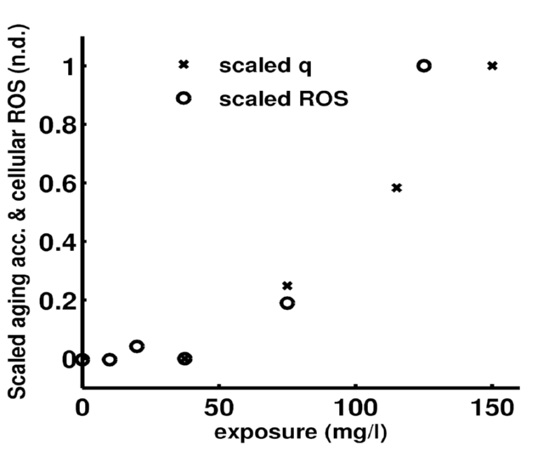
Damage-inducing compounds (q) vs ROS
Scaled ROS
Scaled damage-inducing compounds, q
Exposure (mg/l)

Slide 19
NANO-TOXICITY…
Does it exist?
What are the mechanisms?

Slide 20
Nano-toxicity of CdSe QDs
Dissolved
Cd (Cd(II))
Cd(II)
exposure
Cd(II)
toxicity
Cd(II) effects
on growth
Measured
ROS
Predicted
DamIC (q)
Predicted
growth
FIT
QD
Observed
growth
DISSOLUTION
SELECT TOX.
MECHANISM
CdSe QDs
QD
exposure
Potential
mechanism of
QD toxicity
QD effects
on growth
Maintenance
Energy conductance
Hazard
One additional parameter for toxicokinetics, one for toxicodynamics.

Slide 21
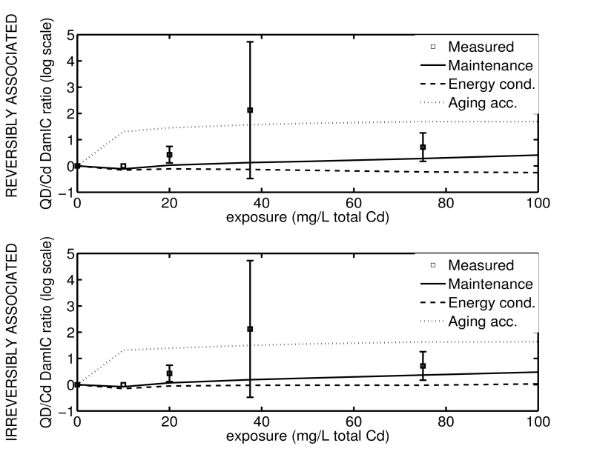
SELECTING TOXICODYNAMICS USING ROS DATA
Exposure (mg/L)
Only toxic effects acting on maintenance are consistent with measurements

Slide 22
Toxicity mediated by ROS
Model capturing dynamics of ROS and damage
Mechanism selection using observables
CAN WE GENERALIZE THE MODEL?

Slide 23
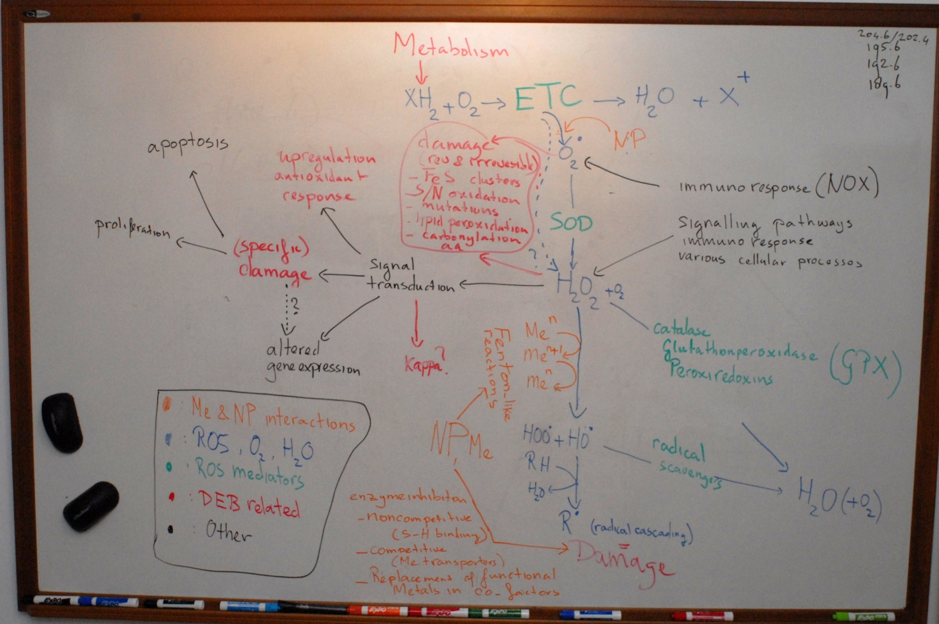
Klanjscek et al. 2016.

Slide 25
Regulation
A_{X}
Waste
Metabolites
Regulation
Regulation
X
X
Metabolites
Linear
Saturating
(handling time)

Slide 26
Model of oxidative stress and damage
ROS, Z
Metabolism
Stress

Slide 27
Model of oxidative stress and damage
ROS, Z
Metabolism
Acceleration
Stress
REVERSIBLE DAMAGE, D

Slide 28
Model of oxidative stress and damage
ROS, Z
Metabolism
Acceleration
Stress
REVERSIBLE DAMAGE, D

Slide 29
Model of oxidative stress and damage
P₀
P_{z}
ROS, Z
Metabolism
γ_{ZS}S
Acceleration
Stress
y_{D}k_{Z}Z
γ_{DS}S
REVERSIBLE DAMAGE, D
Damage creation, P_{D}:
P_{D} = γ_{DS}S + y_{D}k_{Z}Z

Slide 30
Model of oxidative stress and damage
CONTROL OF ROS, E
k_{E}E
(Waste,
Metabolites)
v_{E}Z
K_{E}+Z
P₀
P_{z}
ROS, Z
Inactivation
Metabolism
(Waste)
R_{Z}
γ_{ZS}S
Acceleration
Stress
y_{D}k_{Z}Z
γ_{DS}S
REVERSIBLE DAMAGE, D

Slide 31
Model of oxidative stress and damage
CONTROL OF ROS, E
k_{E}E
(Waste,
Metabolites)
v_{E}Z
K_{E}+Z
P₀
P_{z}
ROS, Z
Inactivation
Metabolism
(Waste)
R_{Z}
γ_{ZS}S
Deactivation rate of ROS, R_{Z}:
Linear: R_{Z}=g_{Z}EZ
Saturating: R_{Z}=g_{Z}EZ
Acceleration
Stress
y_{D}k_{Z}Z
K_{Z}
γ_{DS}S
REVERSIBLE DAMAGE, D
K_{Z}+Z

Slide 32
Model of oxidative stress and damage
CONTROL OF ROS, E
k_{E}E
(Waste,
Metabolites)
v_{E}Z
K_{E}+Z
P₀
P_{z}
ROS, Z
Inactivation
Metabolism
(Waste)
R_{Z}
γ_{ZS}S
Acceleration
Stress
y_{D}k_{Z}Z
γ_{DS}S
REVERSIBLE DAMAGE, D
R_{D}
(Functional biomass,
Metabolites)
Damage repair
v_{A}D
CONTROL OF
DAMAGE, A
k_{A}A
(Waste,
Metabolites)
K_{A}+D

Slide 33
Model of oxidative stress and damage
CONTROL
OF ROS, E
k_{E}E
(Waste,
Metabolites)
v_{E}Z
K_{E}+Z
P₀
P_{z}
ROS, Z
Inactivation
Metabolism
(Waste)
R_{Z}
γ_{ZS}S
Damage repair, R_{D}:
Linear: R_{D}=g_{D}AD
Saturating: R_{D}=g_{D}AD
Acceleration
Stress
y_{D}k_{Z}Z
K_{D}
γ_{DS}S
REVERSIBLE DAMAGE, D
K_{D}+D
R_{D}
(Functional biomass,
Metabolites)
Damage repair
v_{A}D
KONTROLA OŠTEĆENJA, A
k_{A}A
(Waste,
Metabolites)
K_{A}+D

Slide 34
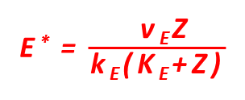
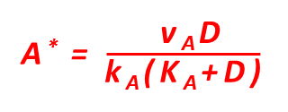
Simplification: equilibration of control
(Waste,
Metabolites)
P₀
P_{z}
ROS, Z
Inactivation
Metabolism
(Waste)
R_{Z}
γ_{ZS}S
Acceleration
Stress
y_{D}k_{Z}Z
γ_{DS}S
REVERSIBLE DAMAGE, D
R_{D}
(Functional biomass,
Metabolites)
Damage repair
(Waste,
Metabolites)

Slide 35
Simplification: equilibration of control
(Waste,
Metabolites)
P₀
P_{z}
ROS, Z
Inaktivacija
Metabolism
(Waste)
R_{Z}
γ_{ZS}S
Ubrzanje
Stress
y_{D}k_{Z}Z
γ_{DS}S
REVERZIBILNA OŠTEĆENJA, D
R_{D}
(Functional biomass,
Metabolites)
Popravak oštećenja
(Waste,
Metabolites)
Klanjscek et al. 2016

Slide 36
Parameterization
proxy for controller: GFP
proxy for response:
PA/PA0 of promoter activity
Friedman et al. 2005. PLoS Biology 3(7):e238

Slide 37
Equilibriums

Slide 38
Advantages
Seamless integration with k-DEB
No need for no-effect concentration (NEC)
Exposure to multiple agents included
Estimte of damage repair costs
Damage memory included
Parameterization possible with data from OMICS
Quantitative predictions enabling hypothesis testing and model selection

Slide 39
DATA (big picture)
Soy exposed to nano-CeO₂
EFFECT
EFFECT
EFFECT
EXPOSURE
EXPOSURE
EXPOSURE
EXPOSURE
EXPOSURE
EXPOSURE
Klanjscek et al. 2017

Slide 40
Soy exposed to nano-CeO₂
0
3
2
1
Height (cm)

Slide 41
Soy exposed to nano-CeO₂
REPRODUCTION
Non-monotonic effect
Energy budget
Toxiconietics
Toxicodynamics
SEED, S or ∑
exposure
Θ
ASSIMILATION
PRODUCTION, P
ABOVE GROUND BIOMASS, ̴W
MAINTENANCE
BACTEROIDS
1-Θ
f_{R}
BELOW GROUND BIOMASS, ̴W
f_{P}
BIOACC. TOXICANT Q
BIOACCUMULATION
GROWTH
Rhizobia exerts a net cost
EXPOSURE | COSTS REDUCING PRODUCTION
NONE | Rhizobia
LOW | Rhizobia + systemic toxicity
MID | Low systemic toxicity
HIGH | High systemic toxicity
Reduction in rhizobia demands

Slide 42
Soy exposed to nano-CeO₂

Slide 43
Pytoplankton and Ag NPs
Stevenson et al. 2013.
Notes:
GREATEST TOXICITY AT HIGHEST GROWTH RATE -- COUNTERINTUITIVE

Slide 44
INTERDEPENDENCIES OF Ag, PHYTPLANKTON & DOC
AgNP
-
Phyto-
plankton
INACTIVE
AgNP
Ag+
Ag+
quota
INACTIVE
Ag+
DOC

Slide 45
Effects of nano-Ag on phytoplankton

Slide 46
Effects of nano-Ag on phytoplankton

Slide 47
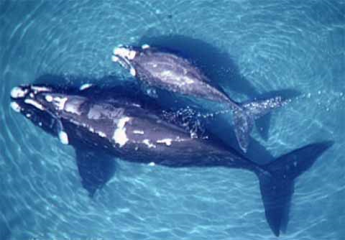
The right whale (to hunt)
 | Southern | Northern
First parturition | 9±2 yrs | 8±2
Calving interval | 3y | 5y
Population status | Growing | Going extinct
Food? Toxicants?
Klanjscek et al. 2007.

Slide 48
The right whale
Haves:
Sparse data
No possibility of experimentation
Weird reproduction
Non-trivial toxicant kinetics
  (diffusion, vertical transfer)
Wants:
Accurate predictions of growth and reproduction as functions of energy availability
Reasonable toxicant dynamics

Slide 49
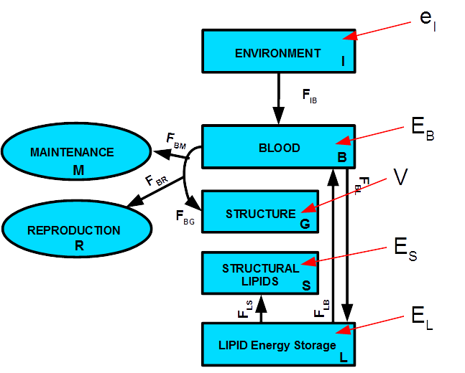
FLUXES ARE NOT REGULATED!

Slide 50
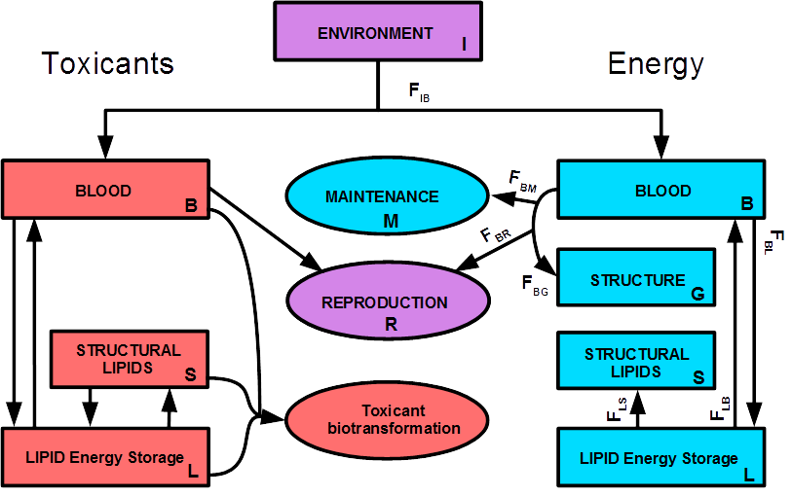

Slide 51
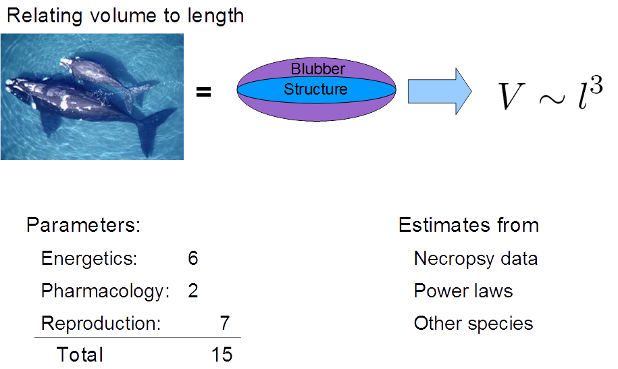
Notes:
Blubber depth reduces about 4.5cm at weaning…

Slide 52
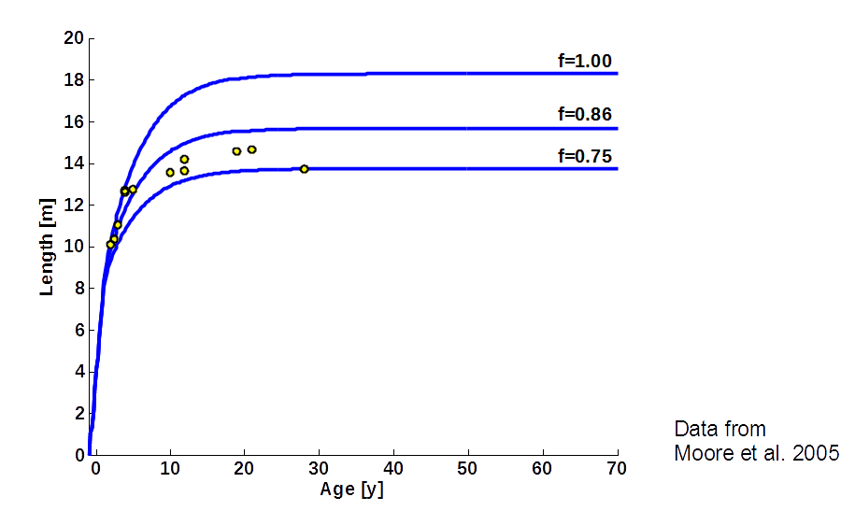

Slide 53
From calving interval (5y): f = 0.9

Slide 54
f fitted to calving intervals predicts
  Growth curve
  First parturition times
Timing of seasonal variability relative to reproductive season affects maturation time and the calving interval
10% difference in f between populations
Lower f -> higher vertical transfer
Mothers loose about 40% of burden
Which calf gets most toxicant depends on f

Slide 55
SITUATIONAL DEB MODELLING
Generality is good, but not necessary for all questions
Easier to explain and understand [vB vs DEB]
Fewer parameters and, therefore, demands on data
Easier to mess up

Slide 56
SITUATIONAL DEB MODELLING
TAILOR-MADE MODELS DERIVED FROM CONCEPTS OF THE DEB THEORY
Loose generality in exchange for
  Simplicity
  Expedience
  Communicability
Danger
  Mass balance
  Consistency

Slide 57
STEPWISE FITTING
FIX A SET OF PARAMETERS BEFORE INCLUDING ADDITIONAL DATA, FIT JUST THE REMAINING PARAMETERS
Helps reduce collinearity
VERY sensitive to assumptions
(the right fit for the wrong reason)

Slide 58
REFERENCES
Klanjšček, Tin; Nisbet, Roger M.; Caswell, Hal; Neubert, Michael G. 2007. A model for energetics and bioaccumulation in marine mammals with applications to the right whale. Ecological applications. 17(8):2233-2250
Nisbet, R.M., Jusup, M., Klanjscek, T. and Pecquerie, L. 2012. Integrating Dynamic Energy Budget (DEB) theory with traditional bioenergetic models. Journal of Experimental Biology 215(6):892-902
Klanjscek, T., Nisbet, R.M., Priester, J.H., Holden, P.A. 2013. Dynamic energy budget approach to modeling mechanisms of CdSe quantum dot toxicity. Ecotoxicology 22(2):319-330.
Klanjscek, T., Muller, E.B., Nisbet, R.M. 2016. Feedbacks and tipping points in organismal response to oxidative stress. Journal of Theoretical Biology
404:361-74. doi: 10.1016/j.jtbi.2016.05.034
Stevenson, L.M., Dickson, H., Klanjscek, T., Keller, A.A., McCauley, E., Nisbet, R.M. 2013. Environmental Feedbacks and Engineered Nanoparticles: Mitigation of Silver Nanoparticle Toxicity to Chlamydomonas reinhardtii by Algal-Produced Organic Compounds PLoS ONE 8(9): e74456
Roger M. Nisbet
Erik B. Muller
John H. Priester
Patricia A. Holden
Louise Stevenson

